Slide 1
Challenges in communication with cancer patients and their relatives: the Belgian, the German and the Netherlands Models
Belgian Society for Psychosocial Oncology
October 26th and 27th

Slide 2
Communication in Oncology
Com-On Approach
Dr. Alexander Wünsch, Dipl.-Psychologist,
Psychotherapist (CBT), Psychooncologist (DKG)
Email: alexander.wuensch@uniklinik-freiburg.de

Slide 3
Agenda
I. Introduction
II. Film „Stop on Track“
III. Why communication skills training?
IV. Communication exercise
V. What is good communication?

Slide 4
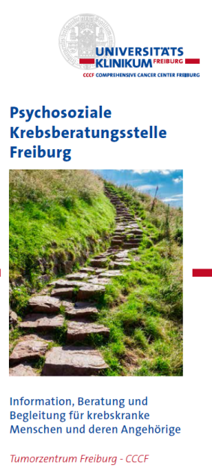


I. Introduction (1)
Psychosocial Support at the Medical Center Freiburg

Slide 5
I. Introduction (2)
Who are you?

Slide 6

II. Film Stop on track
https://www.youtube.com/watch?v=5iexhIc4gus

Slide 7
III. Why Communication Skills Training (CST)? (1)
In 40 years of physician‘s professional life:
150 000 – 200 000 consultations with patients or family members (Fallowfield 2002)
Hardly no training in communication
for psychologist: the key of work

Slide 8
III. Why CST? Effects of good communication
Good communication has an impact on
  reduced psychological distress of patients
  increase of quality in life
  increase in compliance
  reduction of psychological and somatic symptoms
  lower rate in burnout of physicians
  (Stiefel et al., 2006)
  no impact on lengths of consultations
  (Wuensch et al., in preperation)

Slide 9
III. Why CST? Communication can be taught (1)
Not experience, but training improves communication skills of physicians!
Fallowfield (1998)

Slide 10
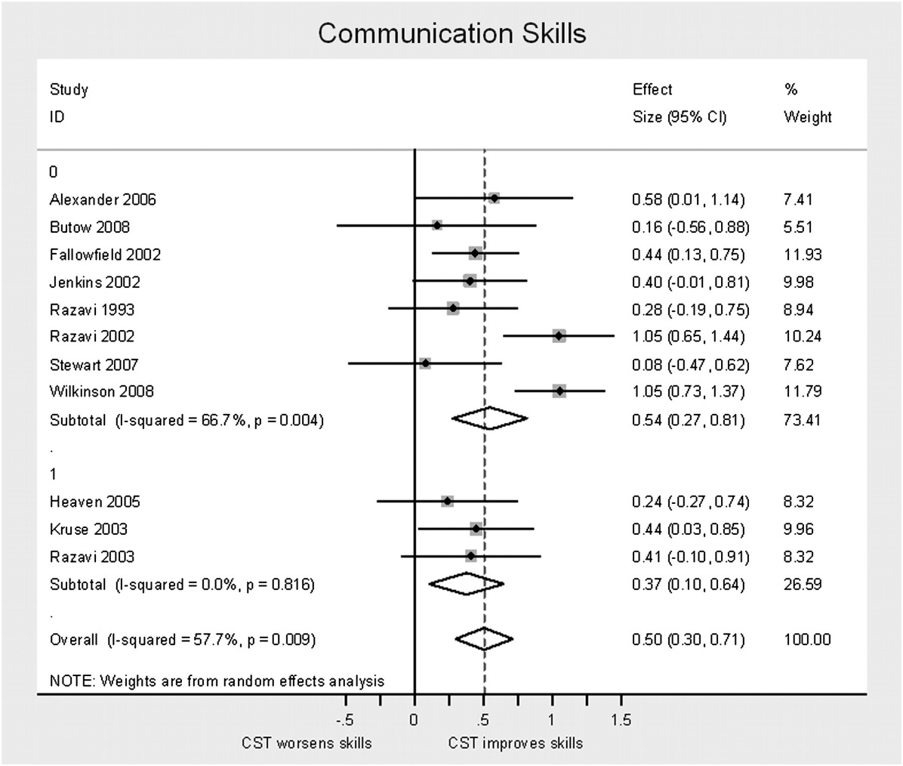
III. Why CST? Communication can be taught (2)
Meta-Analysis: Barth & Lannen 2011
Figure 2: Efficacy of communication skills training on communication skills. Upper part of the figure list studies with no intervention control group. Lower part of the figure shows studies locking at the efficacy of additional supervision or consolidation workshops.
Conclusions:
CST can be taught
CST have middle effect sizes

Slide 11

III. Why CST? Examples of evaluated CST (1)
Com-On phase 1
COM-ON
communication skills in oncology
Information about clinical trials
(A. Wuensch and K. Fritzsche)
The shift from curative to palliative care
(T. Goelz and K. Fritzsche)
Sponsored by
German Cancer Aid e.V. and
a single uncommitted donation by Roche Pharma AG
Kommunikative Kompetenzen in der Onkologie
Freiburger Trainingsprogramm

Slide 12
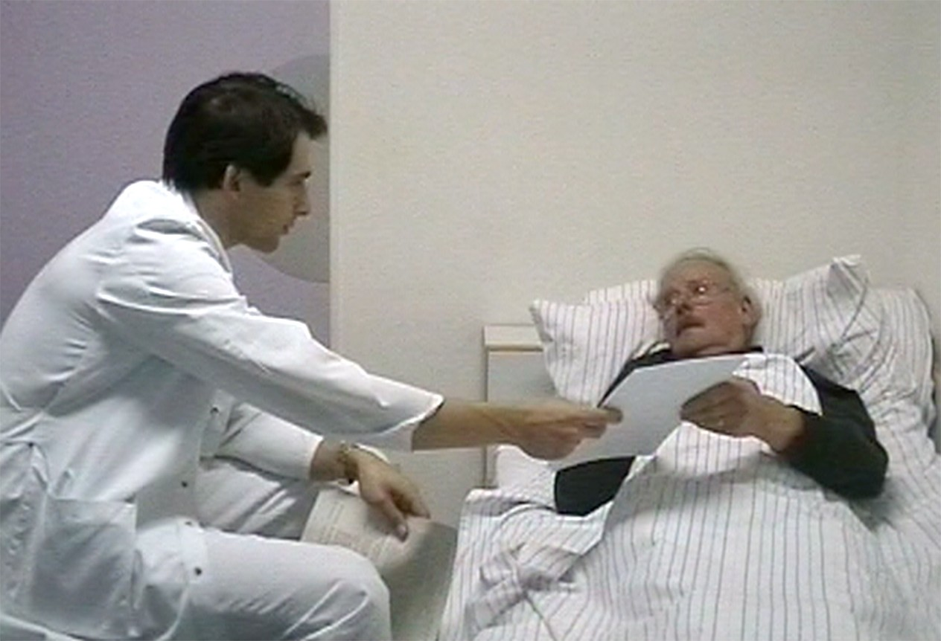
III. Why CST? Examples of evaluated CST (2)
Standardized assessment:
A physician-patient consultation with “Mr Schmidt” about a clinical trials:
RCT, placebo, double blind
Mr Schmidt was trained as a suspicious patient

Slide 13
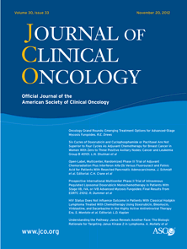
III. Why CST? Examples of evaluated CST (3)
Goelz, Wuensch et al (2011)
Specific training program improves oncologists' palliative
care communication skills in a randomized controlled trial.
Journal of Clinical Oncology 29, 3402-3407
Wuensch, Goelz et al (2017)
Effect of individualized communication skills training
on physicians’ discussion of clinical trials
in oncology:
results from a randomized controlled trial
BMC Cancer (2017) 17:264

Slide 14
III. Why CST? Examples of evaluated CST (4)
Evaluation of CST, Com-On, phase I
High acceptance of trainings
Communication skills can be improved, evaluated in a Randomized Controlled Trail in a standardized setting using actor patients
Middle effect sizes
Limitations: quasi-experimental

Slide 15
III. Why CST? Examples of evaluated CST (5)
CST with real patients: phase 3
Research grant 109980
From CST workshop to clinical practice –
How much coaching is needed?
A RCT about dose-respose of coaching after an individualized
CST for oncologists.
Medical Center Freiburg: Dipl.-Psych. E. Schneid, Marcelo de Figueiredo
Klinikum rechts der Isar, TU Munich: Dr. A. Wünsch (principal investigator)
COM-ON
communication skills in oncology
Kommunikative Kompetenzen in der Onkologie
Freiburger Trainingsprogramm

Slide 16
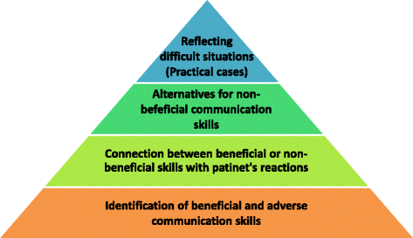
III. Why CST? Examples of evaluated CST (6)
From CST workshop to clinical practice –
How much coaching is needed?
Niglio de Figueiredo et al. (2015) ComOn Coaching: Study protocol of a randomized controlled trial to assess the effect of a varied number of coaching sessions on transfer into clinical practice following communication skills training. BMC Cancer 15:503

Slide 17
III. Why CST? Examples of evaluated CST (7)
Phase 2:
International /intercultural approaches:
ComOn in China
ComOn in Iran
Wuensch et al (2013)
Pang et al (2015)
Phase Assessment
Ratingsskales and Questioannaires
Stubenrauch et al (2012)
Niglio de Figueiredo et al (2017)
Boden & Wuensch (submitted)
Phase 4:
ComOn and Feedback in Medical Education
Engerer et al (2016)
Radzije et al (2017)
Engerer et al (submitted)
Phase 5:
ComOn in
Team – Communication
Bullmann et al (in review)

Slide 18
Tell me and I will forget,
Show me and I will remember,
Let me practice and I will understand
(Konfuzius)

Slide 19
IV. Communication Exercise
Group in pairs
Sit back to back
One will receive a sheet of paper and should discuss, what (s)he sees
The other one takes notes
5 minutes

Slide 20
V. What is good communication?

Slide 21
SPIKES - Modell (Baile 2000)
SETTING
PERCEPTION
INVITATION
KNOWLEDGE
EMOTION
SUMMARY

Slide 22
SPIKES - Modell (Baile 2000)
Setting
Perception
Invitation
Knowledge
Emotion
Summary
  Calm and private setting
  Plan enough time for consultation
  Tell, how much time you have
  Same eye level
  Keep eye contact

Slide 23
SPIKES - Modell (Baile 2000)
  Ask whether patient is ready for consulation now „is it okay when we talk about the results?“
  Assess patient‘s perception of current situation with open questions: „Could you tell me in your own words, how you see your situation?“
  „I see that you prefer complementary medicine and that you have difficulties with the proposed chemotherapy. What kind of information do you have about this chemotherapy?“
  Clarify possible wrong perceptions
Setting
Perception
Invitation
Knowledge
Emotion
Summary

Slide 24
SPIKES - Modell (Baile 2000)
Setting
Perception
Invitation
Knowledge
Emotion
Summary
  Questions about what kind of information is needed:
  „How detailed whould you like to be informed?“

Slide 25
  General communication skills
  Adequate language
  Good nonverbal communication:
  e.g. eye contact
  Pause after 3 information units at least for 3 seconds
  Invite for questions:
  „If you do not understand someting,
  please be free and ask questions.“
  Check understanding:
  „Did you understand the protocol?“
Setting
Perception
Invitation
Knowledge
Emotion
Summary

Slide 26
SPIKES - Modell (Baile 2000)
Setting
Perception
Invitation
Knowledge
Emotion
Summary
Visualize! (draw it down)

Slide 27
Emotion: NURSE by BACK
Setting
Perception
Invitation
Knowledge
Emotion
Summary
          N aming
        U nderstanding
        R espect
        S upport
        E xplore

Slide 28
Emotion: NURSE by BACK
  Naming: Address emotions:
  „I can see this is quite distressing for you.“
  Understanding: Show honest understanding:
  „I can understand that you think all is collapsing now.“
  Respecting: Show respect:
  „I see you are really well informed about therapy options.“
  Supporting: Normalize and support: Be aware what is really possible! „We will support you now on this path“ „You did very well with coping this situation and I think,
  you will manage this upcoming step as well“
  Exploring: Open questions: „Are there any other things you worry about?“

Slide 29
SPIKES - Modell (Baile 2000)
Setting
Perception
Invitation
Knowledge
Emotion
Summary
  Summarize
  „Mrs. X, we discussed a lot now….Could you summarize
  the essentials in your own words now?“
  Check understanding
  „The next steps are very important and quite complex.
  Could you summarize in your own words?“
  Invite for questions
  „If you have any more questions,
  please come to us and clarify your questions.“
  Offer additional support
  (nursing, psychooncology, social, spiritual)
  „The next steps are ….
  please make an appointment for the next week.“

Slide 30
SPIKES - Modell (Baile 2000)
Setting
Perception
Invitation
Knowledge
Emotion
Summary
  N aming
  U nderstanding
  R espect
  S upport
  E xplore

Slide 31
Application of SPIKES
Idea of how to structure a good consultation
Application should be flexible and patient centered

Slide 32
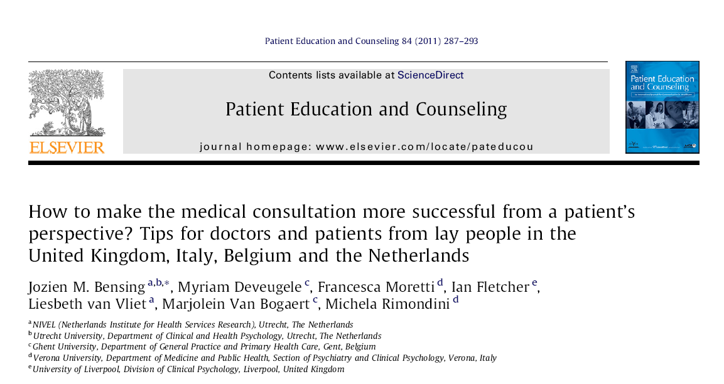

Slide 33
Methods
Multicenter Study GULiVer
  Gent (B), Utrecht (NL), Liverpool (UK), Verona (I)
  lay people in a shopping center
Procedure
  trigger tapes: video of an OSCE
  focus groups with suggestions for a good consultation

Slide 34
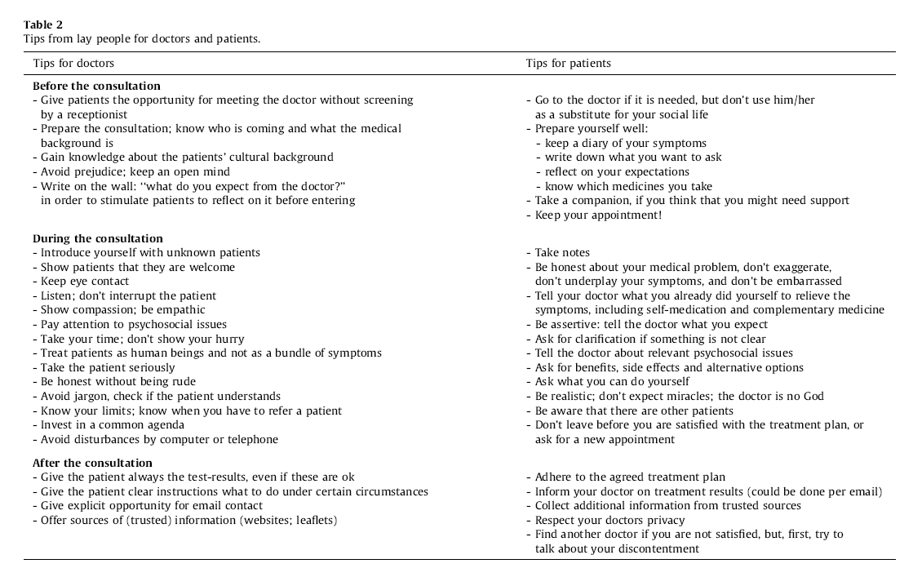
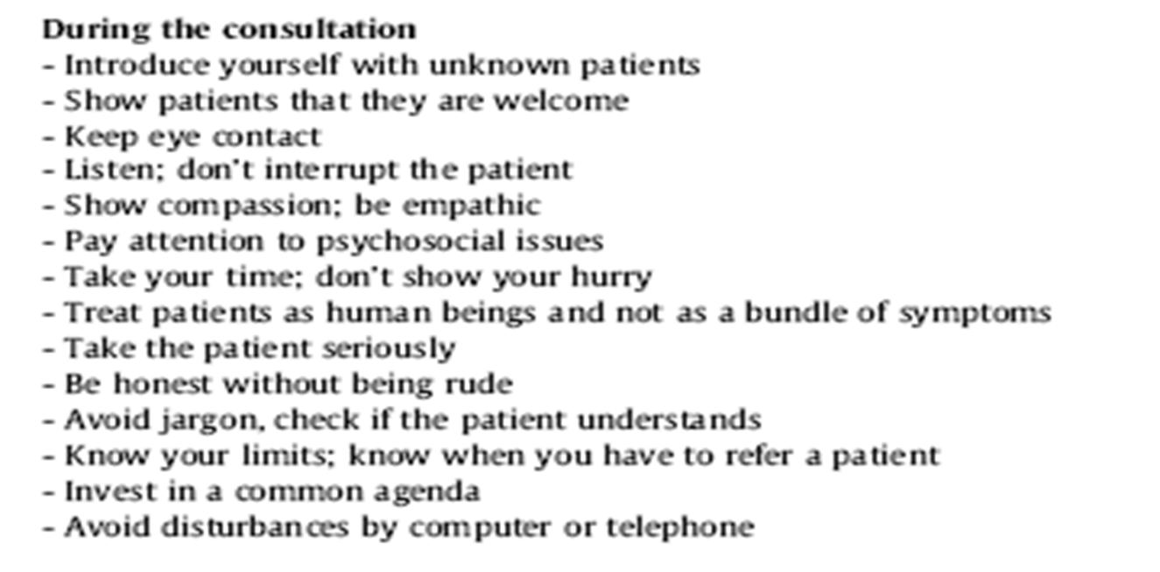
Results

Slide 35
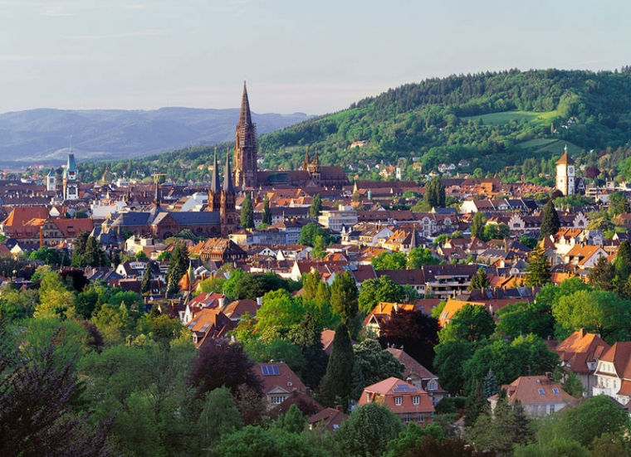
Thank you for your attention!
Email: alexander.wuensch@uniklinik-freiburg.de

Slide 36
Je me réjouis de vos commentaires et questions!
Tijd voor uw commentaren en vragen!
I am happy for your comments and questions!
Ich freue mich auf Ihre Kommentare und Fragen!

